Slide 1

FINNISH HEALTH DATA HACKATHON
Patient Access Track
December 15, 2025
Notes:
Remember the recording!

Slide 2







Slide 3
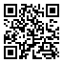
AGENDA
What Is the Finnish Health Data Hackathon?
Patient Access Track
Finnish SMART IG
City of Helsinki / Apotti / Epic
Kanta
xShare
Identity Wallets & NCP
fhir.fi/hackathon

Slide 4

©️ Still Words Photography clients.stillwords.com/EHiN2025
Notes:
Vendors get feedback on their API specifications and implementations.
Also learn of new use cases and existing implementations.

Slide 5

©️ Still Words Photography clients.stillwords.com/EHiN2025
Notes:
Discuss about the specifications. This is how I interpret it, and why.
Give feedback – it is possible to interpret this part in this and this way.
It’s possible to implement this part in this and that way.
Specs always aim to be clear and unambiguous. It’s hard.

Slide 6

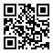
fhir.fi/hackathon

Slide 7
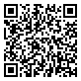
HL7 Finland 30 Years Symposium
Monday, 19 January 2026
Same premises as the hackathon
Requires different registration!
Draft agenda:
9.30-10.00 Coffee 10.00-12.00 Finnish sessions 12.00-13.00 Lunch 13.00-16.00 International sessions 16.00- Networking and drinks
www.hl7.fi/kokoukset-ja-tapahtumat/hl7-finland-30th-anniversary-symposium/

Slide 8
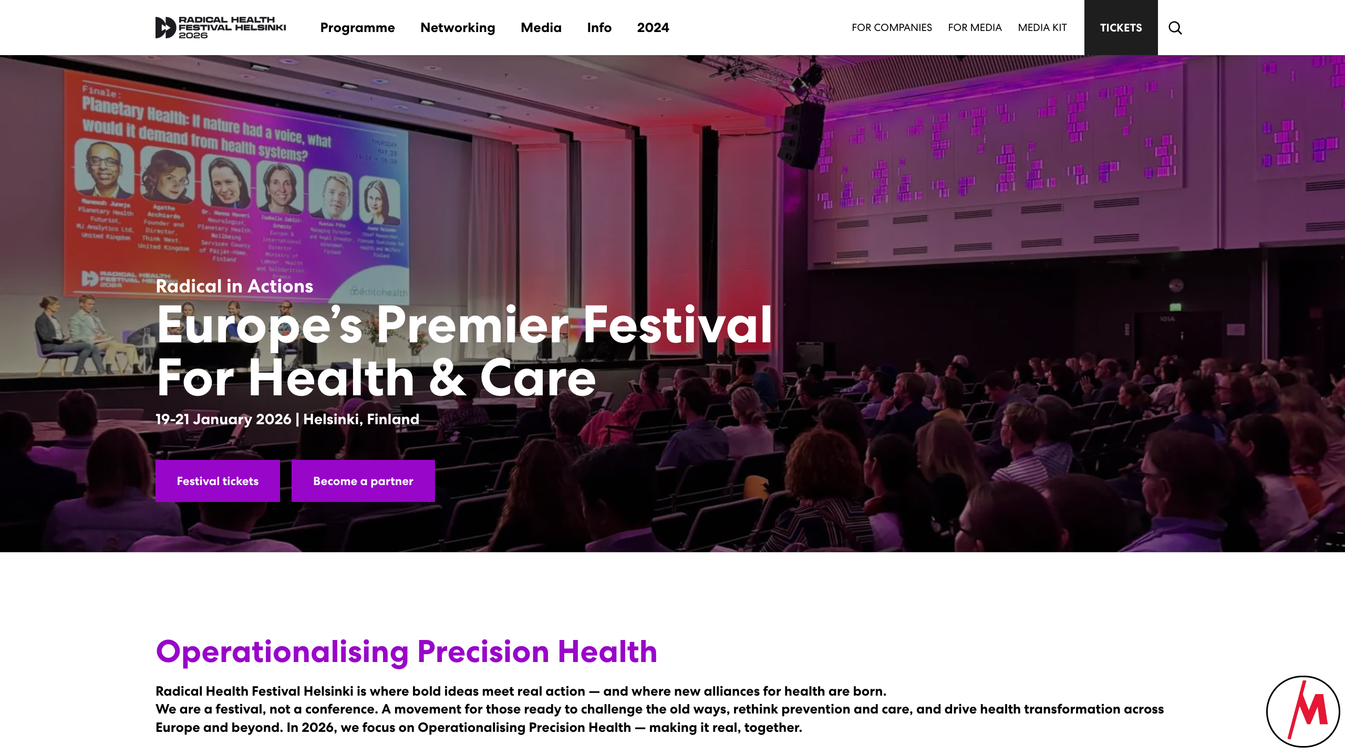
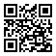
radicalhealthfest.com

Slide 9

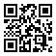
laakaripaivat.fi

Slide 10
When & Where
Monday, January 19, 2026, starting at 9:00 EEST
Some tracks continue on Tuesday, January 20, 2026
Results presented on Wednesday, January 21, 2026

Slide 11
Participation
Register in advance
No costs involved!
Notes:
for the main hackathon on Monday
Radical Health Festival and Lääkäripäivät require a paid registration

Slide 12
Topics
Patient Access track of the Finnish Health Data Hackathon

Slide 13
Finnish SMART IG

Slide 14
City of Helsinki / Apotti / Epic
Notes:
Challenge
Separate webinar coming up
Apotti Ecosystem
Fhir.epic.com
Maisa

Slide 15
Kanta APIs
Notes:
Patient Access API
Personal Health Record

Slide 16
xShare

Slide 17
Digital Identity Wallets, NCP
Notes:
MyHealth@MyHands
Website
Description
MyData Global
Project description?

Slide 18
Participating
Patient Access track of the Finnish Health Data Hackathon

Slide 19
Notes:
Registration form!

Slide 20
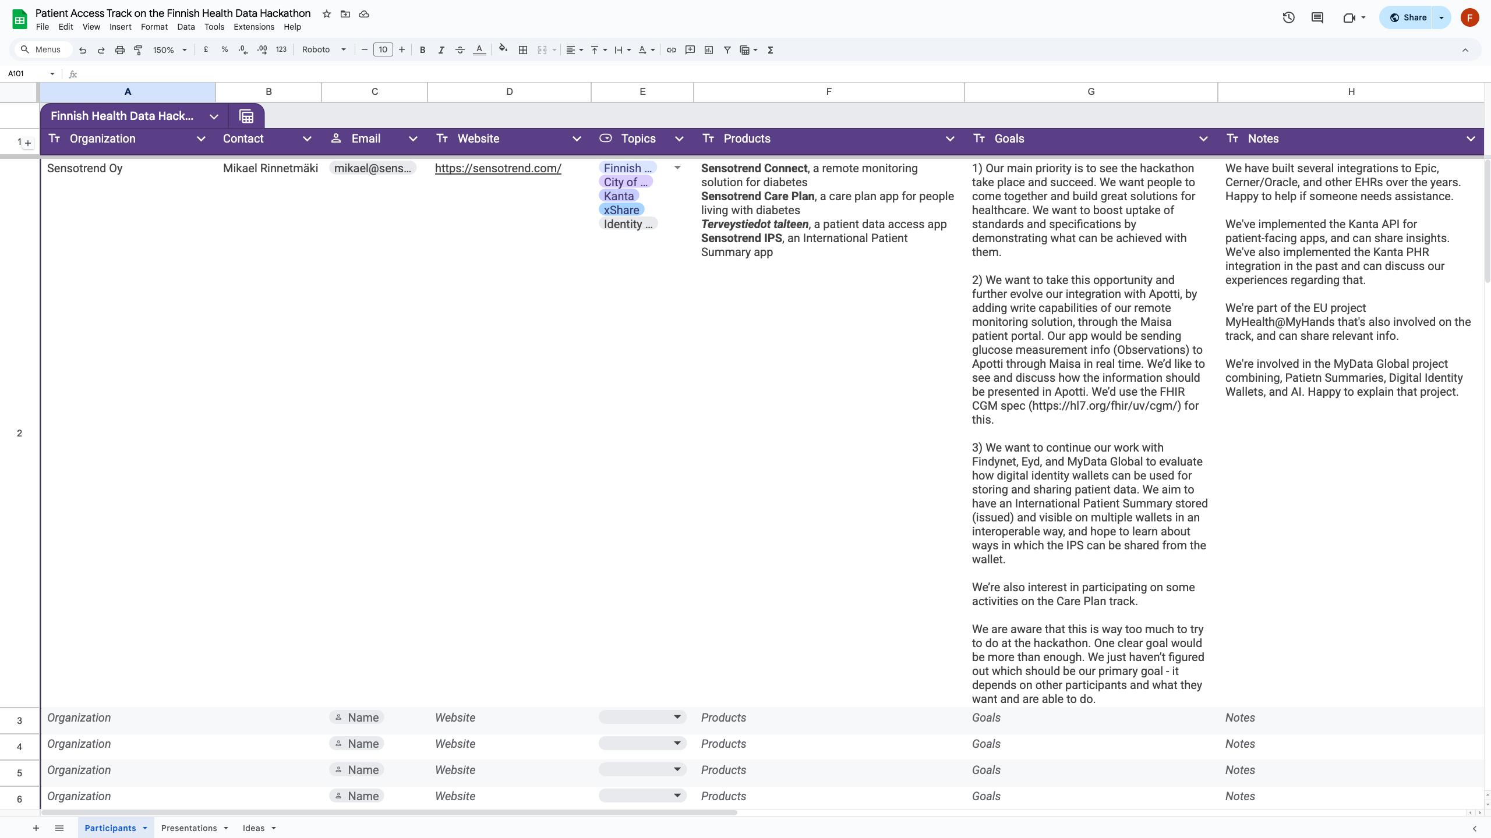

Slide 21
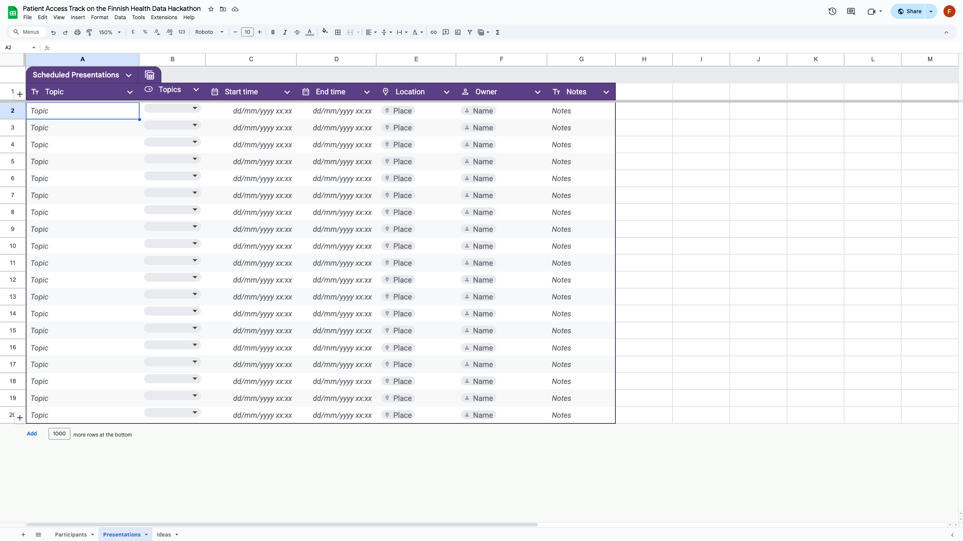

Slide 22
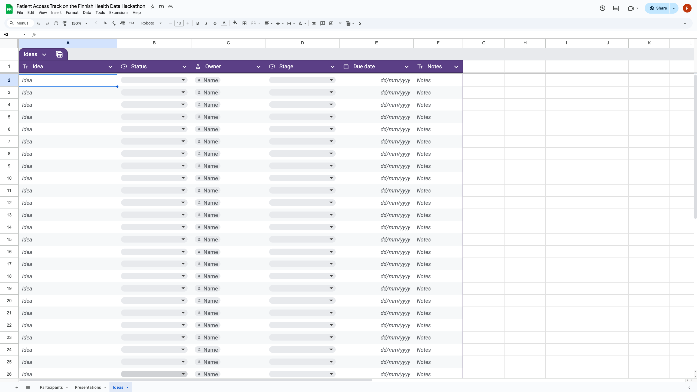

Slide 23
Sponsors

Slide 24
Q&A
Patient Access track of the Finnish Health Data Hackathon

Slide 25
Next Webinars
City of Helsinki / Apotti / Epic
Tuesday, Dec 16, 13:00 CET
Care Plans and Clinical Reasoning
Thursday, December 18, 14:00 CET
Wallets, national contact points (NCP)
Friday, December 19, 11:00 CET

Slide 26
Thank you for participating!

